Slide 1

Coding in R For Healthcare Informatics and Health Data Science
Kimberly Deas, MS, PhD Candidate
BlackTIDES Informatics Lead
Notes:
Entered text
Coding in R For Healthcare Informatics and Health Data Science
### 1. Introduction to R (5 minutes)
**Note:** Focus on verbal explanation and slides for this part.
- Welcome and brief overview of the webinar.
- Introduction to R: Explain what R is, its importance in data analysis, especially in medical and health-related fields.
"Welcome, everyone! I'm thrilled to have you join me today as we dive into the dynamic and ever-evolving world of R. Think of R not just as a programming language, but as your new superpower in the realm of data analysis. We're going to unravel the mysteries of how this powerful tool plays a pivotal role, particularly in the medical and health sectors. Imagine being able to decode complex health data or predict medical trends with just a few lines of code - that's the magic of R! Whether you're a budding data enthusiast or aspiring to be a healthcare data wizard, today's session is your launchpad. We’ll explore R’s capabilities in making sense of vast amounts of data through statistical analysis and eye-catching visualizations. Get ready to embark on an exciting journey where data meets healthcare, and where your skills can make a real difference in understanding and improving human health. Let's get started and unlock the potential of R together!"
### 2. Basics of R (10 minutes)
• **Getting Started with R: Installation and Setup**
- Instructions on installing R and RStudio (verbal or slide-based).
• **Overview of RStudio**
- Demonstrate RStudio's interface: Source, Console, Environment/History, Files/Plots/Packages/Help (verbal or slide-based).
** Reference Books and Courses
-
• **Basic R Syntax and Commands**
```R
# Variables and data types
age <- 30 # Numeric type
patient_id <- "P001" # Character type
smoker <- TRUE # Logical type
# Basic operations
new_age <- age + 1
print(new_age)
# Data structures: vector, matrix, list, data frame
vector <- c(1, 2, 3)
matrix <- matrix(1:9, nrow=3)
list <- list(age, patient_id, smoker)
data_frame <- data.frame(ID=c(1,2), Name=c("Alice", "Bob"))
```
### 3. Overview of the Dataset (5 minutes)
**Introduction to the Dataset**
- General introduction to a typical cardiovascular dataset.
**Loading the Dataset in R**
```R
# Loading the dataset
cvd_data <- read.csv("path_to/dataCVD.csv")
```
**Exploratory Data Analysis**
```R
# Structure of the data
str(cvd_data)
head(cvd_data)
summary(cvd_data)
```
### 4. Data Manipulation and Analysis (15 minutes)
**Data Cleaning**
```R
# Handling missing values
cvd_data$age[is.na(cvd_data$age)] <- mean(cvd_data$age, na.rm = TRUE)
cvd_data <- na.omit(cvd_data)
# Data transformation
cvd_data$age_group <- ifelse(cvd_data$age > 50, "Above 50", "50 or Below")
```
**Basic Data Analysis Techniques**
```R
# Descriptive statistics
summary(cvd_data$blood_pressure)
# Simple visualizations
hist(cvd_data$age)
# Bar chart
barplot(table(cvd_data$smoking_status))
# Scatter plot
plot(cvd_data$age, cvd_data$cholesterol_level)
```
**Using Packages for Data Manipulation and Visualizations**
```R
# dplyr and ggplot2
library(dplyr)
library(ggplot2)
# Data manipulation with dplyr
cvd_data <- cvd_data %>%
filter(age > 18) %>%
arrange(desc(cholesterol_level))
# Advanced visualizations with ggplot2
ggplot(cvd_data, aes(x=age, y=blood_pressure)) +
geom_point() +
labs(title="Age vs Blood Pressure", x="Age", y="Blood Pressure")
```

Slide 2
This presentation provides an introduction to coding in R for healthcare informatics and health data science. We’ll cover the basics of R, including installation and setup, as well as data manipulation and analysis techniques. We’ll end with live coding of a healthcare data set.

Slide 3
Part 1: Introduction to R

Slide 4

Part 1: Introduction to R
What is R?
Why R is Useful in the Healthcare Data Analytics Field?
Why R is useful in the healthcare data analytics field.
R Resources

Slide 5
Introduction to R: What is R?
R is a versatile programming language and software environment, highly regarded for statistical computing, data analysis, and data visualization.
As an open-source tool, it's supported by a robust community and offers a vast repository of packages for statistical and data manipulation tasks.
It excels in handling large datasets and complex analyses, while its straightforward syntax makes it accessible to users at all levels.
R's integration with other languages and various data formats enhances its adaptability in a wide range of data scenarios.

Slide 6
Introduction To R: Why R is used in Statistical and Data Analysis.
R's popularity in statistical and data analysis is driven by its comprehensive statistical techniques, covering everything from linear and nonlinear modeling to time-series analysis.
Its strength lies in a vast array of user-contributed packages that simplify complex tasks and adapt to evolving methodologies.
R's advanced plotting systems like ggplot2 enable the creation of detailed and insightful visualizations.

Slide 7

Introduction To R: Why R is Useful in the Healthcare Data Analytics Field?
R plays a crucial role in healthcare data analytics with its proficiency in handling large, complex datasets common in medical research and public health.
Its specialized packages for biostatistics and epidemiology, such as 'survival' and 'lme4', are essential tools in medical research for analyzing trends and patterns in health data.
R excels in predictive modeling and machine learning, key for developing personalized medicine and forecasting disease outbreaks.
Additionally, its ability to visualize health data simplifies complex information, aiding in effective communication for healthcare decision-making.

Slide 8
Introduction To R : Resources
IMO, THE definitive book on R: R for Data Science: Import, Tidy, Transform, Visualize, and Model Data 2nd Edition by Hadley Wickham (Author), Mine Çetinkaya-Rundel (Author), Garrett Grolemund (Author)
R Course: https://www.udemy.com/course/r-programming/. Kirill is also a great Tableau instructor.
Others?

Slide 9
Part 2: Basics of R

Slide 10
Basics of R: Getting Started with R: Installation and Setup
Installing R and R studio: https://rstudio-education.github.io/hopr/starting.html

Slide 11
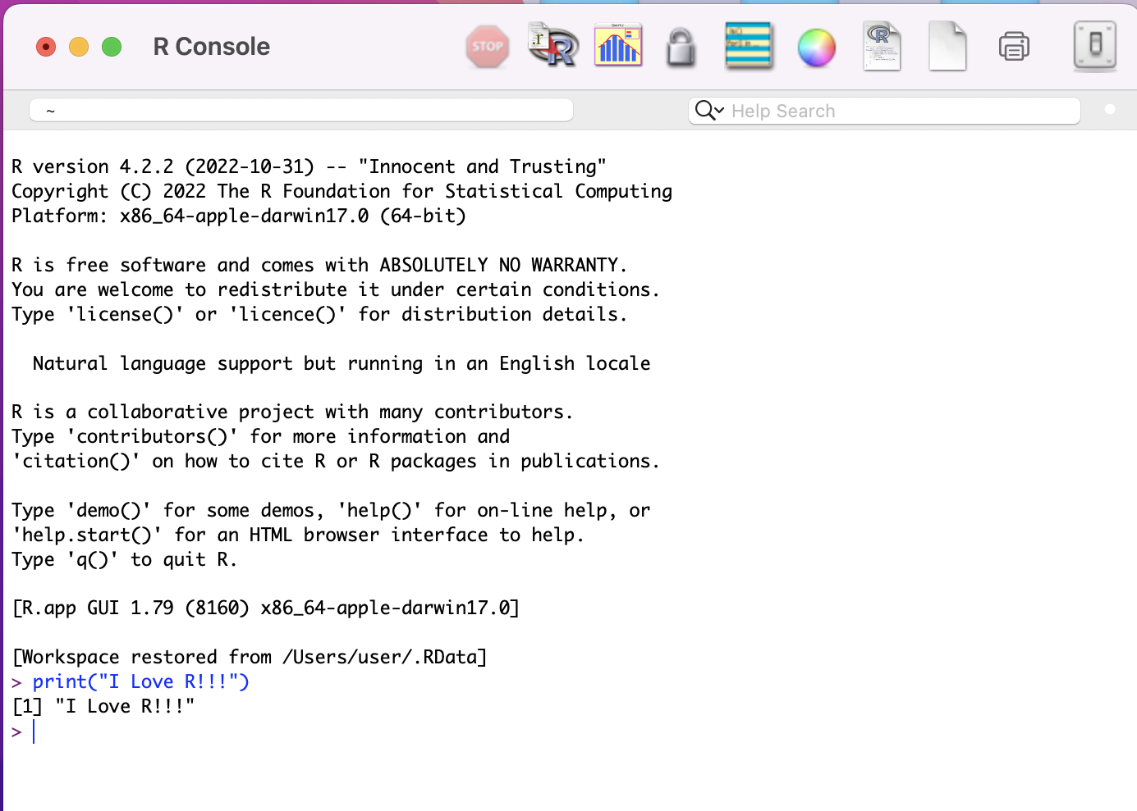
Basics of R: R Console

Slide 12
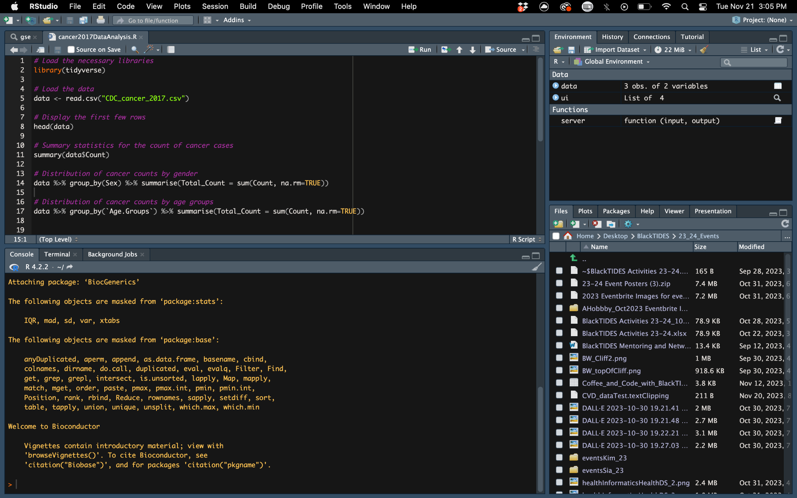
Basics of R: R Studio

Slide 13
Live demo R Studio – The Basics
- Source Pane
This is where users write and edit their R scripts.
- Console Pane
This is the area where R code is executed and results are displayed.
- Environment and History Panes
The Environment tab shows the current working dataset, including variables, datasets, and functions. The History tab acts as a log of previously run commands.
- Files, Plots, Packages, and Help Panes
These panes provide quick access to file directories (Files), graphical outputs (Plots), R package management (Packages), and R documentation (Help).

Slide 14
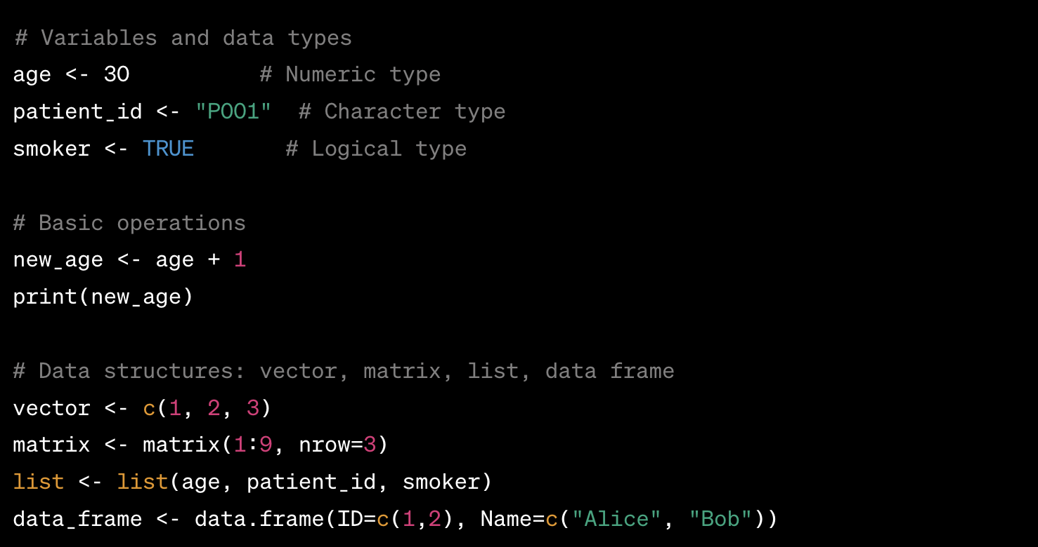
Basics of R: Basic R Syntax and Commands

Slide 15
Part 3: Overview of the Dataset

Slide 16
Basics of R: Overview of the Dataset
Look at your data
Loading the Dataset in R
Console

Slide 17
Part 4: Data Manipulation and Analysis

Slide 18
Data Manipulation and Analysis : Data Cleaning
Check for proper data types, convert as needed
Checking for NAs
Handling missing values
Data Transformation
Console

Slide 19
Data Manipulation and Analysis: Basic Data Analysis Techniques
Exploratory Data Analysis
Descriptive statistics
Simple Visualizations
Bar chart
Scatter plot
Console

Slide 20
Data Manipulation and Analysis: Using Packages for Data Manipulation and Analysis
dplyr and ggplot2
Data Manipulation with dplyr
Advanced data viz with ggplot2
Console

Slide 21
Thank you. Please feel free to ask any questions. 😄

